Slide 1
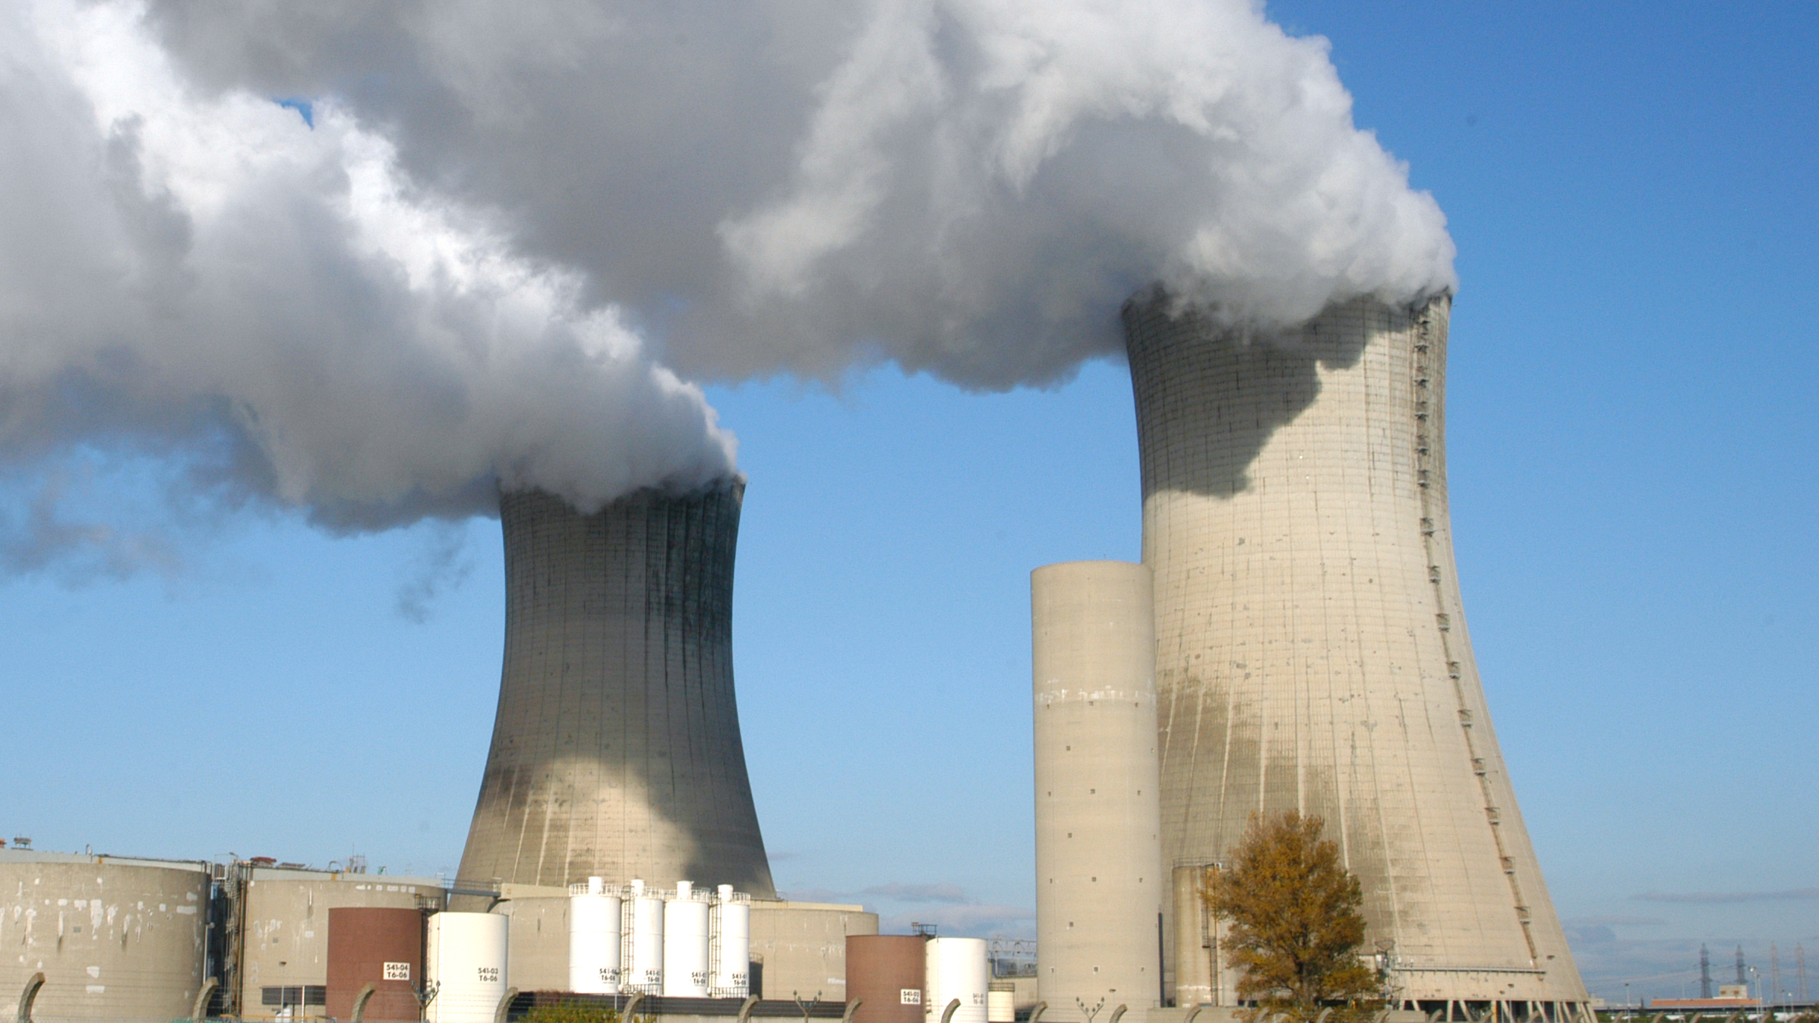
Calma, 2004, CC
Notes:
https://www.flickr.com/photos/iaea_imagebank/8168889853/in/photolist-drRGmv-4nMgRt-i59pE5-aZF7SR-aVWkxp-i59Pra-U2rnpG-aVWksz-RX8AcC-drRGjn-dMeA1V-drRGJH-RPNywP-S1JRQc-ncFQvr-cN4Bho-o5CsPu-aVWqo2-QJg5mU-4aWeJ5-dXCysr-fAaYES-dXJeYS-dXCy8V-R1g3WU-9pPXvU-5f6Z4A-nNzfgx-fKr1RC-eJ94r-8k9x5B-aVWpii-od2xPm-2QiJXz-4nMacB-Shb2Lq-aVWkje-i597Ju-drRRj3-d1swRS-aVWqQP-dM66ts-drRGMg-qrrHnZ-fKr2Ay-aVWr4n-aY46xk-epDWU-bwxMVR-e52SF
IAEA Imagebank 04710032
Eurodif Nuclear Power Plant, Tricastin, France
Photo Credit: Dean Calma / IAEA
http://www.capitol.hawaii.gov/hrscurrent/Vol01_Ch0001-0042F/05-Const/CONST_0011-0008.htm
NUCLEAR ENERGY
Section 8. No nuclear fission power plant shall be constructed or radioactive material disposed of in the State without the prior approval by a two-thirds vote in each house of the legislature. [Add Const Con 1978 and election Nov 7, 1978]

Slide 2
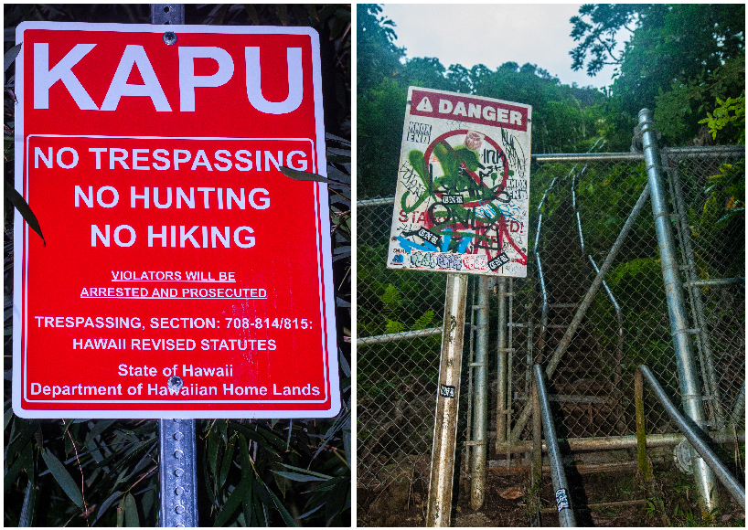
Benson, 2014 CC
Notes:
http://brentbensonphotography.com/blog/?p=379
HRS 708-814, -814.5, and -815
Criminal Trespassing

Slide 3

HDA, 2017
Notes:
http://hawaiidispensaryalliance.org/call-me-cannabis/

Slide 4
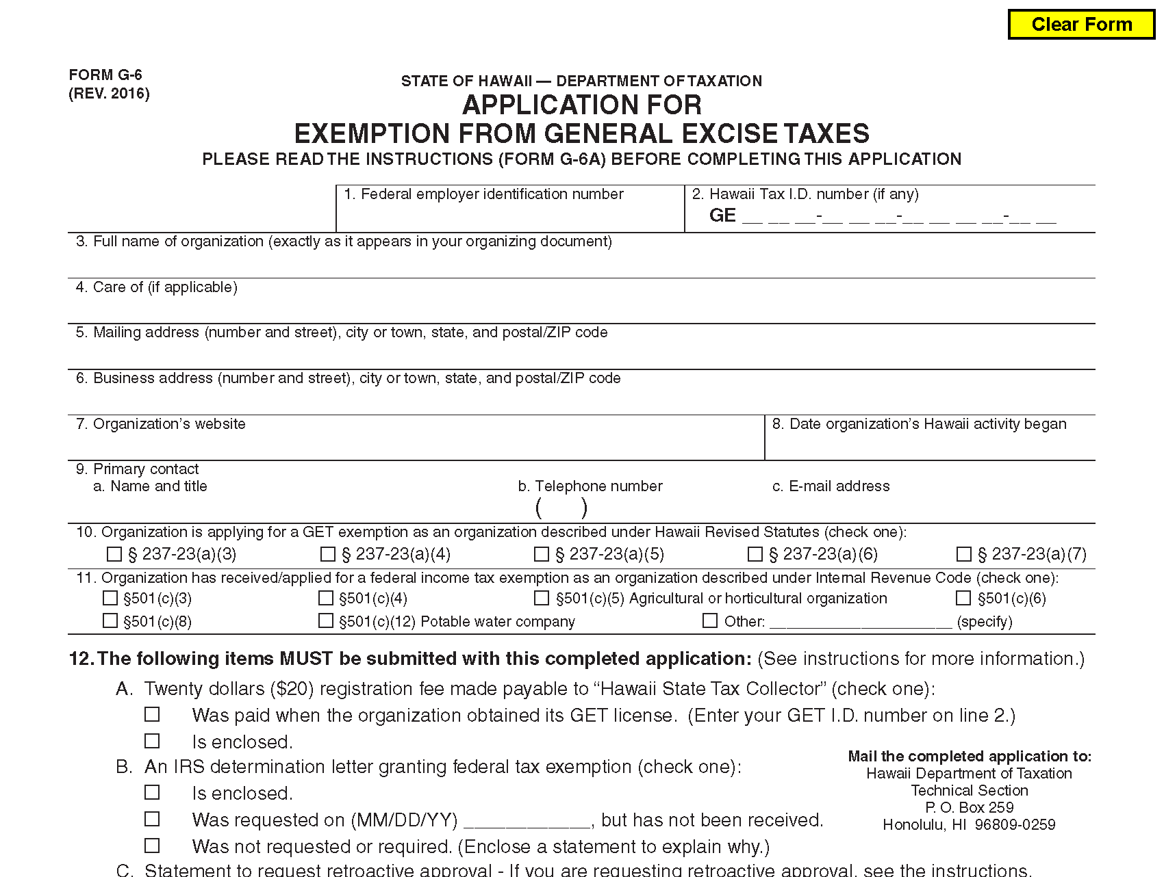
Notes:
http://files.hawaii.gov/tax/forms/2016/g6.pdf
GET Exemption

Slide 5
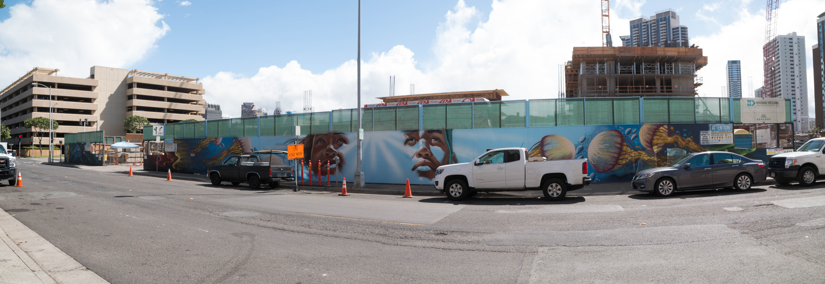
Criscola, 2016 CC
Notes:
Charlie Boy Criscola, Kaka‘ako
https://www.flickr.com/photos/charlieboy808/27192234184/in/photolist-HqTiRS-6mPTX7-dGEQf8-dGLfCh-EqELkp-azVHFm-8hPSW2-dGEPrR-5bGakS-dTTtKt-oqwytR-7Mbjir-9A2ARH-Jd3y8s-aekDne-7GybTc-8hPMUt-azT54x-hjb8wF-Jffxrv-LcSsxw-azT6oH-aQ91C-JmYH38-q3c3jQ-azT5Xr-7Mbhj4-HqTnKU-dGESSD-8fQMnL-Jd3a2s-dTTtqc-aspJjn-7GC86h-a8jwUe-dGLhhU-HqTmdA-JiV7gu-8hT5Y1-dGEQt2-7Mbhwv-aeot5s-7b3rAk-dTZ75G-6mPUbo-Ezbfvy-dGLisA-azVJtU-dGEQY8-dGESd4

Slide 6
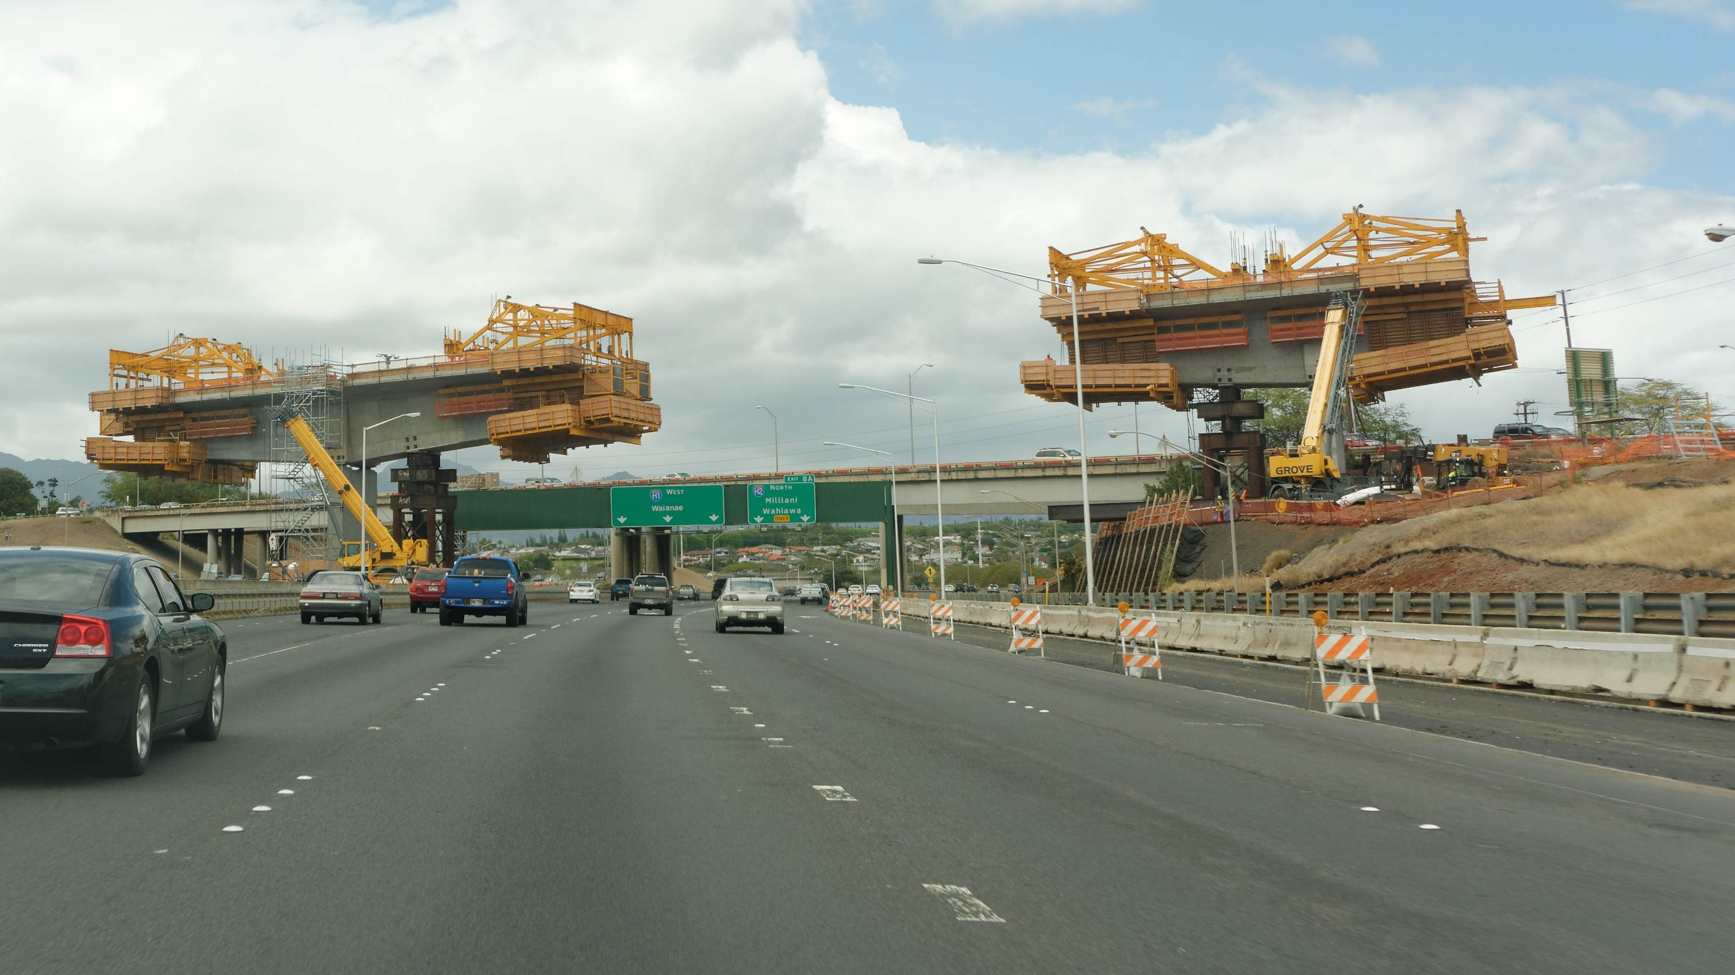
Ramirez, 2015 CC
Notes:
Daniel Ramirez
HART Rail Construction
Overhanging track pieces over the freeway.
https://www.flickr.com/photos/danramarch/18599627918/in/photolist-ukzXnY-fizrrV-9RwcAN-bswUGs-bGw5vv-btBg3m-dPR9Zx-bHiBhX-bHiBuv-ccuSXh-6q4ZsP-6VW4Vn-9PrMJR-ccuSbW-6W15a5-ccv5Eq-ccuT6G-5uG7FT-bV8Cpg-9PrMMM-JdM5Ga-JdM9NX-bV8Cs8-6VW556-bV8CTv-bV8CFB-bV8BSP-ccuTx7-ccuTAu-ccuTWf-ccuSRw-bV8BxZ-ccuSUG-ccuWdQ-ccuSp7-ccuWbm-bV8C1Z-bV8FBD-C1mJ7i-KacKbp-JdMawa-K7c5pf-UqZsvB-ccuX8q-K7c6pw-KacH2V-BQukUW-K6YWfy-rnUL84-K6YX3A

Slide 7
The draft EIS shall address all probable adverse environmental effects which cannot be avoided. Any adverse effects such as water or air pollution, urban congestion, threats to public health, or other consequences adverse to environmental goals and guidelines established by environmental response laws, coastal zone management laws, pollution control and abatement laws, and environmental policy such as that found in chapters 128D, 205A, 342B, 342C, 342D, 342E, 342F, 342G, 342H, 342I, 342J, 342L, 342N, 342P, and 344, HRS, shall be included, including those effects discussed in other actions of this paragraph which are adverse and unavoidable under the proposed action.
Notes:
HAR 11-200-17(l)

Slide 8
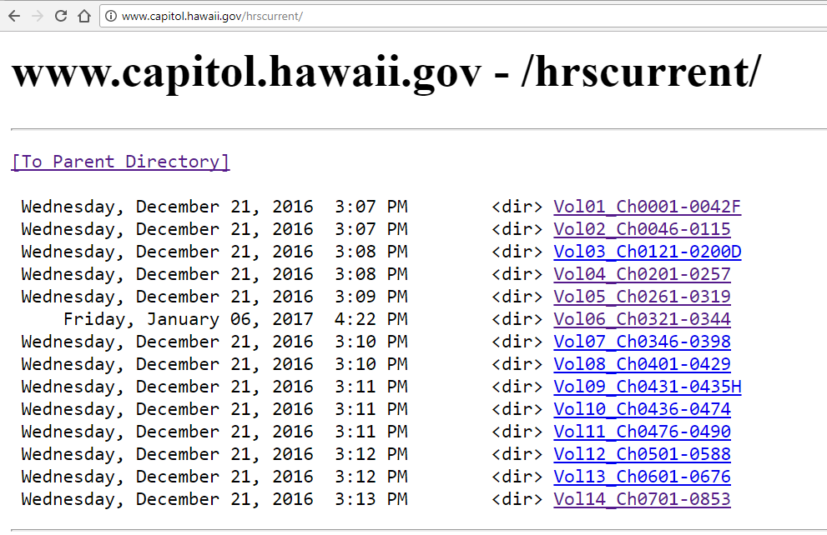

Slide 9
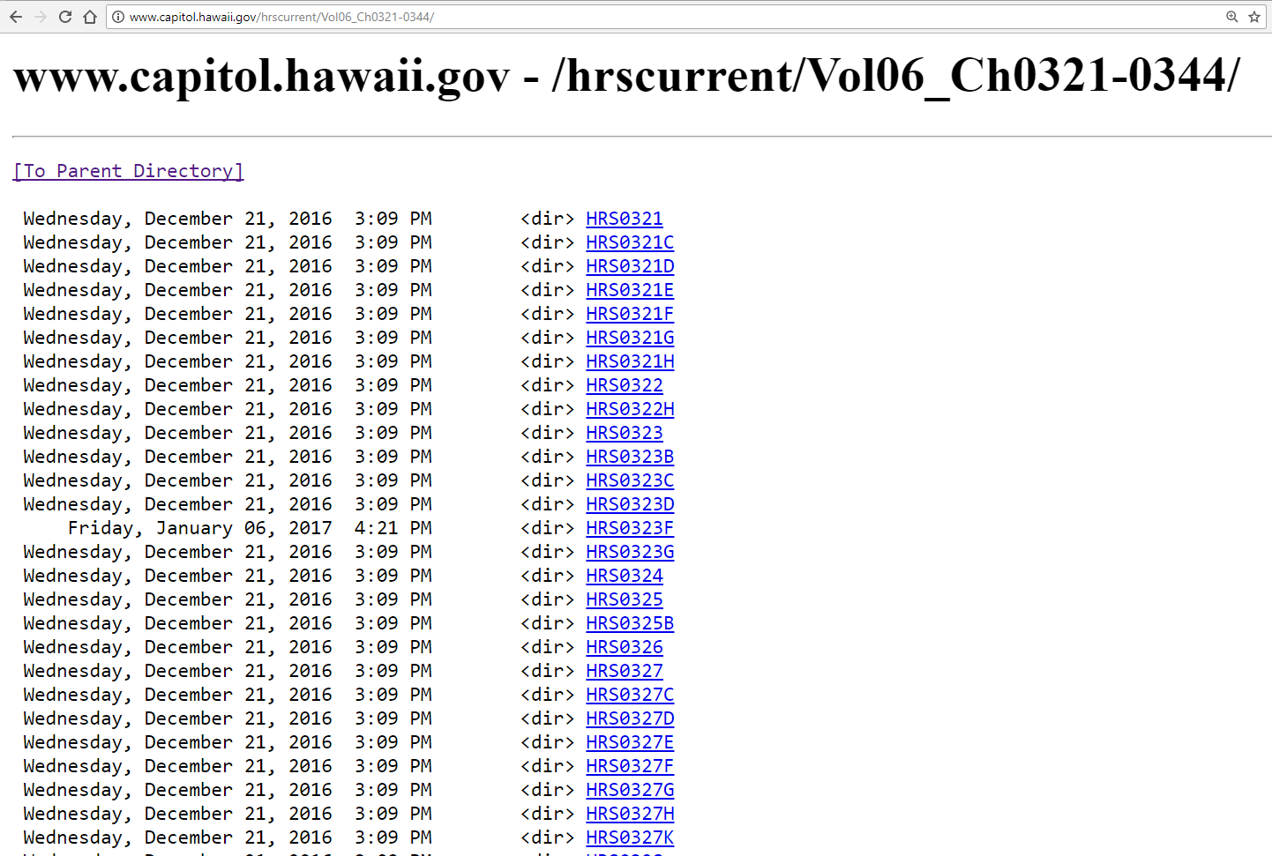

Slide 10
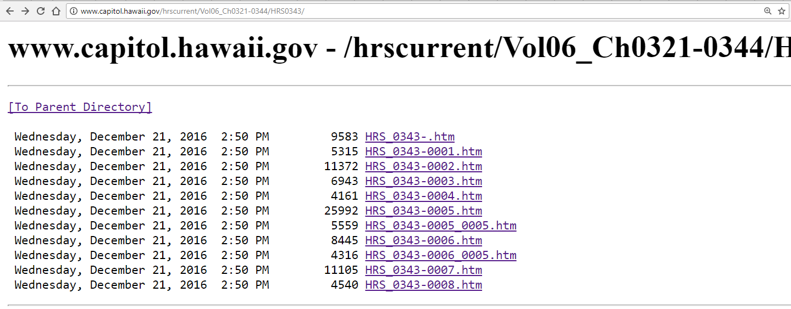

Slide 11
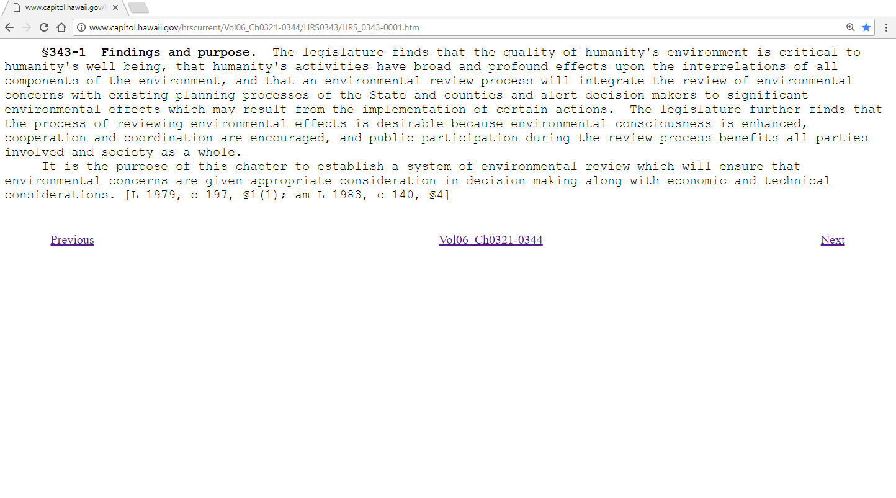

Slide 12
§343-1 Findings and purpose. The legislature finds that the quality of humanity's environment is critical to humanity's well being, that humanity's activities have broad and profound effects upon the interrelations of all components of the environment, and that an environmental review process will integrate the review of environmental concerns with existing planning processes of the State and counties and alert decision makers to significant environmental effects which may result from the implementation of certain actions. The legislature further finds that the process of reviewing environmental effects is desirable because environmental consciousness is enhanced, cooperation and coordination are encouraged, and public participation during the review process benefits all parties involved and society as a whole.

Slide 13

Starr, 2015 CC
Notes:
Forest Starr and Kim StarrFollow
Another Day at the Office - West Maui Mountains
We were doing aerial reconnaissance, to check on suspect locations of rapid ohia death, a new disease of Metrosideros, thankfully all
https://www.flickr.com/photos/forest-and-kim/21793491960/in/photolist-CD4xfU-D9sstL-DoU54m-DoTMH5-Dwhz7j-DyATCD-TBZ3uE-TNgUay-DrcY6a-zcPkTo-CB5GfX-AF3owT

Slide 14
Department of the Attorney General
David Moore, Administrative Services Officer
david.t.moore@hawaii.gov
808-586-1282
Office of Environmental Quality Control
Department of Health
Scott Glenn, Director
scott.glenn@doh.hawaii.gov
808-586-4185

